Slide 1
Lesson objective
You will need whiteboards and a calculator for this lesson.
Title: Naming angles
Aim:
Recall facts for supplementary and complementary angles
Use correct notation for naming angles
Plan:
Topic refresh and practice
Naming angles
Skills practice

Slide 2
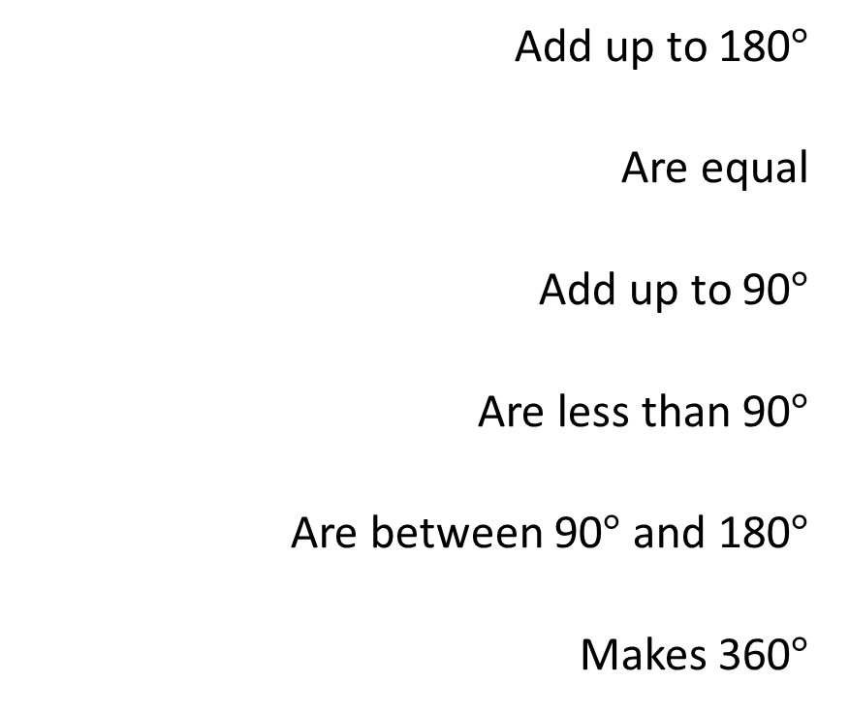
Topic refresher
Vertically opposite angles
Obtuse angles
Acute angles
A full rotation
Supplementary angles
Complimentary angles
Add up to 180$°$
Are equal
Add up to 90$°$
Are less than 90$°$
Are between 90$°$ and 180$°$
Makes 360$°$

Slide 3

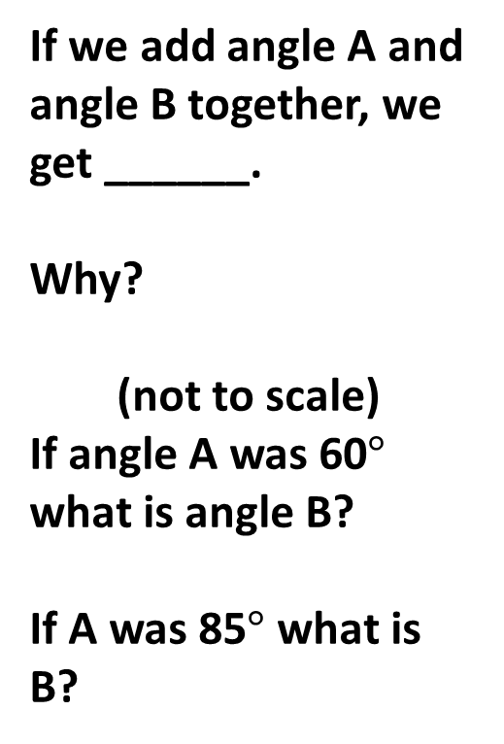
Complementary angles
If we add angle A and angle B together, we get ______.
Why?
(not to scale)
If angle A was 60$°$ what is angle B?
If A was 85$°$ what is B?
A
B

Slide 4



Whiteboards
Complementary angles add up to $90°$
Write an equation and solve the unknown angle.
x$°$
30$°$

Slide 5



Whiteboards
Complementary angles add up to $90°$
Write an equation and solve the unknown angle.
75$°$
x$°$

Slide 6


Whiteboards
Complementary angles add up to $90°$
Write an equation and solve the unknown angle.
15$°$
x$°$

Slide 7
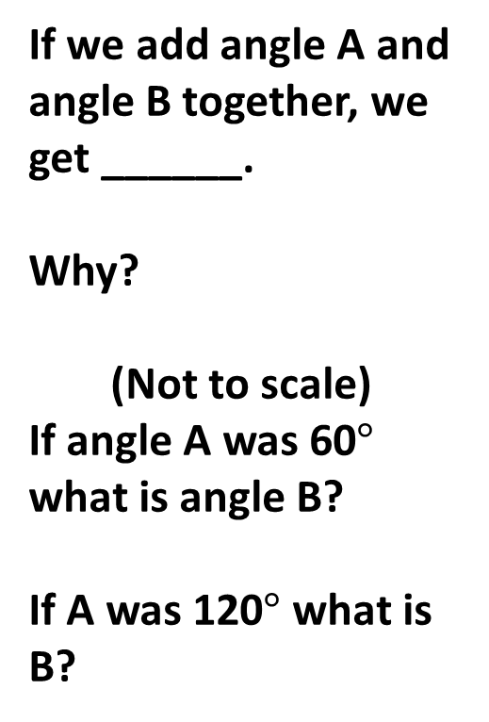
Supplementary angles
If we add angle A and angle B together, we get ______.
Why?
(Not to scale)
If angle A was 60$°$ what is angle B?
If A was 120$°$ what is B?
A
B

Slide 8


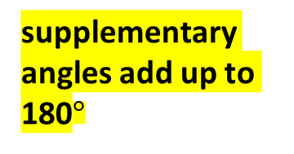
Whiteboards
supplementary angles add up to 180$°$
Write an equation and solve the unknown angle.
140$°$
x$°$

Slide 9


Whiteboards
supplementary angles add up to 180$°$
Write an equation and solve the unknown angle.
70$°$
x$°$

Slide 10


Whiteboards
supplementary angles add up to 180$°$
Write an equation and solve the unknown angle.
95$°$
x$°$

Slide 11
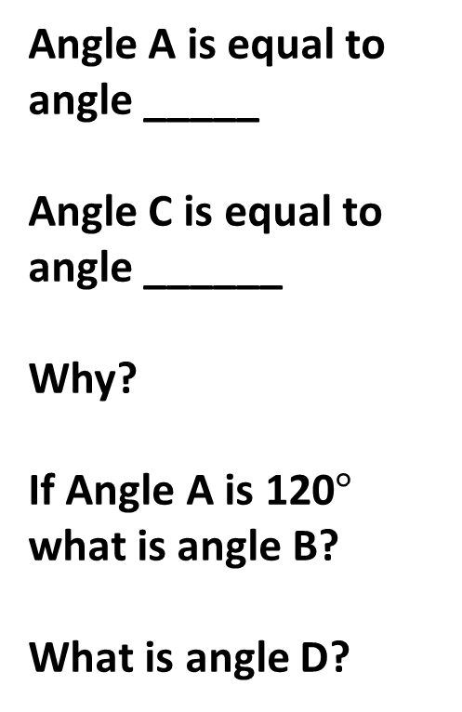
Vertically opposite angles
Angle A is equal to angle _____
Angle C is equal to angle ______
Why?
If Angle A is 120$°$ what is angle B?
What is angle D?
A
C
D
B

Slide 12




Whiteboards
Vertically opposite angles are equal.
Solve the unknown angles x and y.
100$°$
y$°$
80$°$
x$°$

Slide 13



Whiteboards
Vertically opposite angles are equal.
Solve the unknown angles x and y.
x$°$
y$°$
40$°$
140$°$

Slide 14



Whiteboards
Vertically opposite angles are equal.
Solve the unknown angles x, y and z.
supplementary angles add up to 180$°$
130$°$
y$°$
z$°$
If we add all these angles together, what do we get?
Why?
x$°$

Slide 15

Naming angles
A
This diagram can be labelled as ∠ABC
Notice that B is at the vertex of the angle and middle of notation.
C
B

Slide 16
Naming angles
X
This diagram can be labelled as ∠XYZ
Notice that y is at the vertex of the angle and middle of the notation.
Z
Y

Slide 17
Why is it important?
We use notation for angles a lot in mathematics. Especially when it comes to working with triangles (which you will see in year 8, 9, 10 and possibly 11 and 12).
This notation helps to identify specific angles within triangles or diagrams.

Slide 18


Which angle?
Here we have ⏶ABC
Using whiteboards name:
The red angle
The green angle
The yellow angle
A
C
B

Slide 19


Is ∠ABD red or yellow?
A
Answer:
It’s the sum of both.
∠ABC is red
∠CBD is yellow
∠ABD is red and yellow
C
D
B

Slide 20
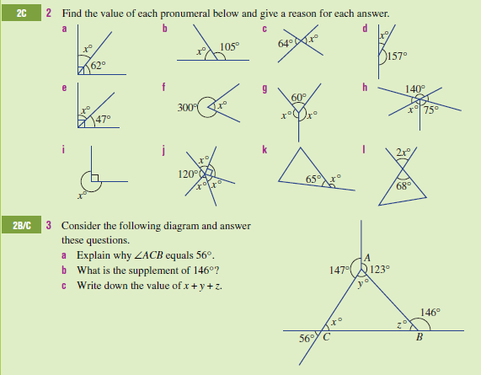
Complete these questions in your exercise book.

Slide 21
Checking aims: fist to five
Recall facts for supplementary and complementary angles
Use correct notation for naming angles
Go back and put your number in each box.

